Slide 1
Automation Opportunities
A
B
C
D
aa
aaaaa
cc
ccccc
dd
bb
ddddd
bbbbb

Slide 2















Opportunities Matrix
Early Feedback
$•$Spelling check
$•$Draft reminder
$•$Preliminary Date check
$•$Scope check
Comms & Notification
$•$Final version to retailer
Ease
$•$Status confirmation
$•$Due content notification
$•$Introduce RequiredBy
$•$Topic and experience tags
Reduce Manual Checks
$•$Publish date, event occurrence
$•$Performance feedback
$•$Previous version comparison
$•$Personalized content
$•$Applicable date range
Personalization & Performance Review
$•$Guideline compliance
Attractiveness/Value

Slide 3


Gender Profiles
69%
Female
31%
Male
75%
IOS Users.
bla
bla.
bla.
bla.
bla.
62%
44%
48%
43%
46%
78%
80%
72%
78%
84%
80%

Slide 4

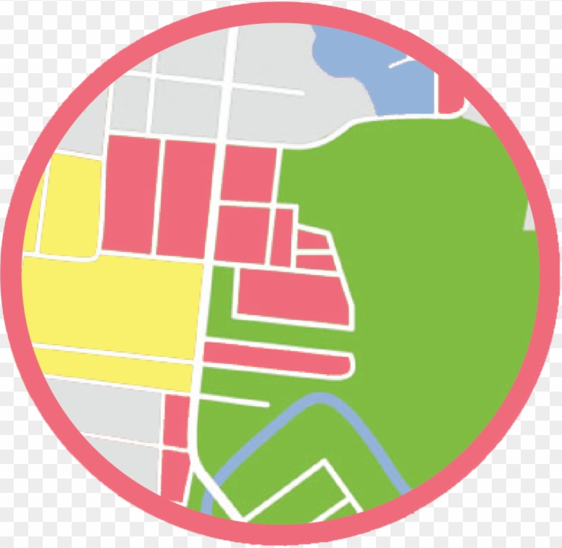




Wifi Data Use Cases
Measure Campaign Performance
bla
Understand Precinct Attractiveness
bla
Enrich Customer Profile
blah
Enable Dynamic Interactions
blah
Provide Gender Reference
blah

